Slide 1
Patient Survival Prediction
Team Details
Batch Details | JAN22
Team Members | Aakriti Gulati Ciana S Raj Md Sharib Zeya Misha Rajagobi Sheetal Yadav
Domain of Project | Predictive Analysis
Proposed Project Title | Patient Survival Prediction
Group Number | 01
Team Leader | Md Sharib Zeya
Mentor Name | Animesh Tiwari

Slide 2
AGENDA
Introduction
Problem Understanding
Business Objective
Data Understanding
Data Preprocessing
Data Analysis
Hypothesis Testing

Slide 3
INTRODUCTION
Industry Review
Domain:- Predictive Analysis
Prediction using Statistical modeling, Data mining techniques and Machine learning.
Health care
Increasing requirement of medical care.
Process of analyzing current and historical industry data to predict trends.
Dataset:- Patient Survival Prediction
Hospital_death will be used as the main key area in the Dataset.

Slide 4
PROBLEM UNDERSTANDING
Problems related to doctors, nurses, and support staff
Inadequate ICU drugs and equipment
Improper maintenance of equipment and facilities
Problem caused by other related units (laboratory, Accident and Emergency unit, Operation Room)
Absence of treatment protocol
Improper communication (Inter and intra departmental)
Delay in consultation due to lack of commitment and team work
Delay the Lab. reports

Slide 5
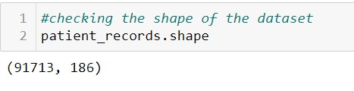
DATA UNDERSTANDING
Dataset consisting of information on patient identifiers, their age, bmi, height, weight, vitals, comorbidity, chronic condition and whether they survived or not.
The data was collected by Global Open Source Severity of Illness Score (GOSSIS), a new in hospital mortality prediction algorithm for predicting survival prediction .
About The Dataset
Identifier
Demographic
Apache Covariate
Vitals
Labs
encounter_id
hospital_id
patient_id
age
bmi
elective_surgery
ethnicity
apache_2_diagnosis
apache_3j_diagnosis
apache_post_operative
d1_diasbp_noninvasive_min
d1_resprate_min
d1_spo2_max
d1_wbc_min
h1_creatinine_min
h1_glucose_max

Slide 6
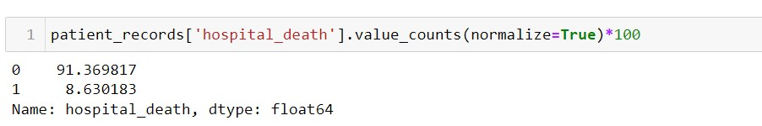
DATA DESCRIPTION
RECORDS - 91713
ATTRIBUTES - 186
Target variable : hospital_death
Indicating the survival prediction in case of number of cases concerning the ICU .
BINARY VARIABLES
Only 16 Columns constitute of binary variable
CATEGORICAL VARIABLES
Only 8 columns constitute of object datatype
NUMERIC VARIABLES
162 numerical columns ; 7 discrete and 155 continuous columns
Numerical variables do contain some null values.
They are both of int64 and float64 datatype
hospital_death,ethnicity,gender,hospital_admit_source,icu_admit_source ,icu_stay_type ,icu_type ,apache_3j_bodysystem ,apache_2_bodysystem

Slide 7
Data Preprocessing
Data Quality Assessment
Imputation of missing values
1.5 – 92%
Outlier Treatment
Handling categorical data
Feature Scaling

Slide 8
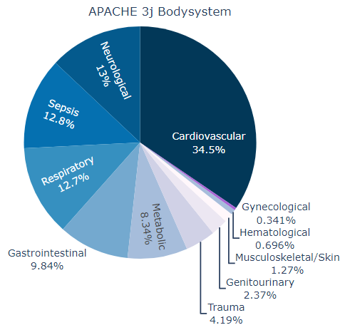
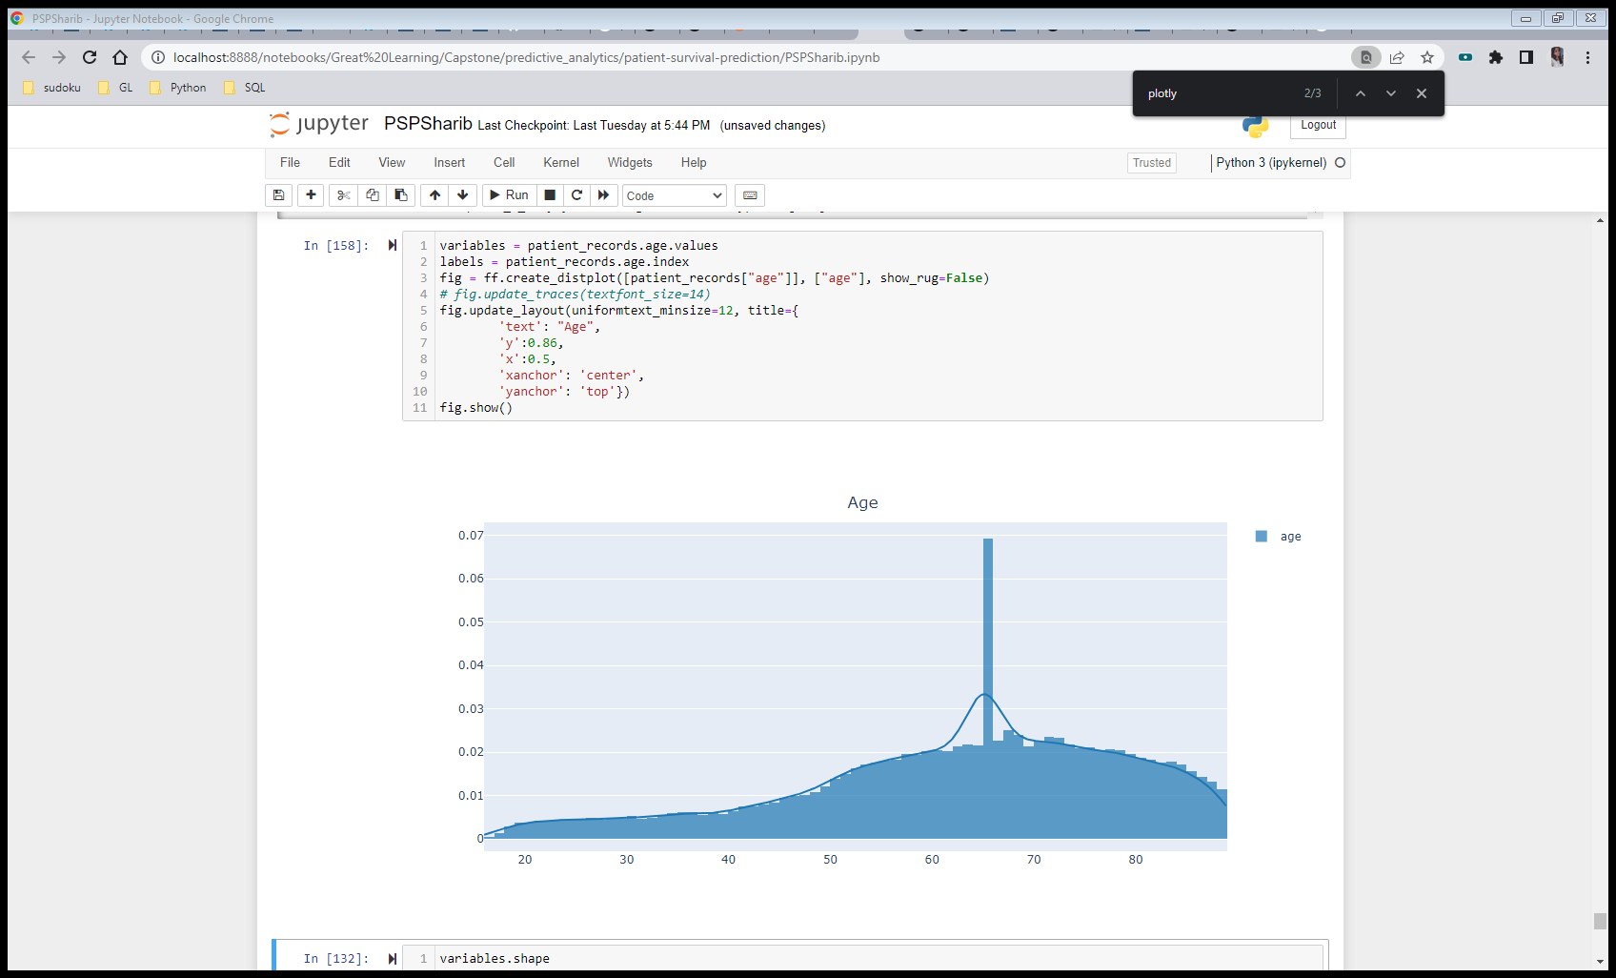
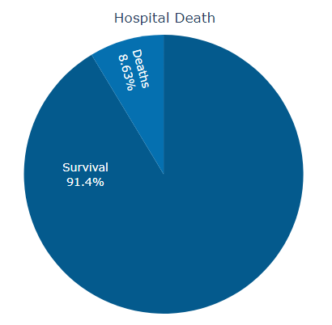
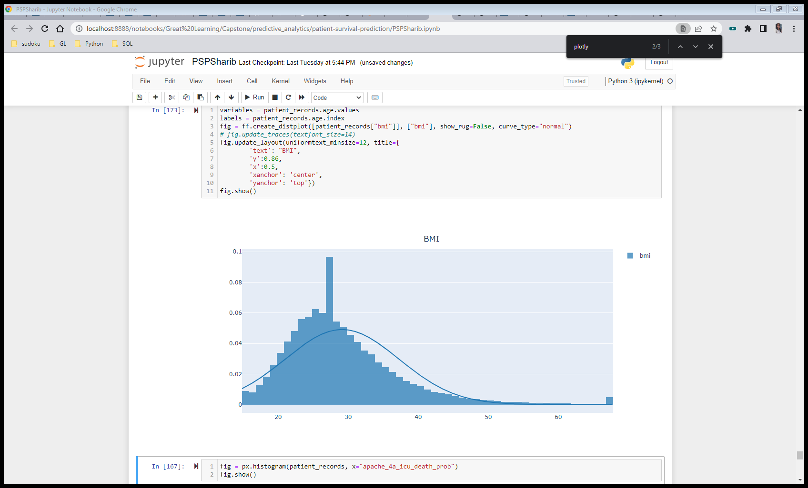
Exploratory Data Analysis Univariate Analysis

Slide 9
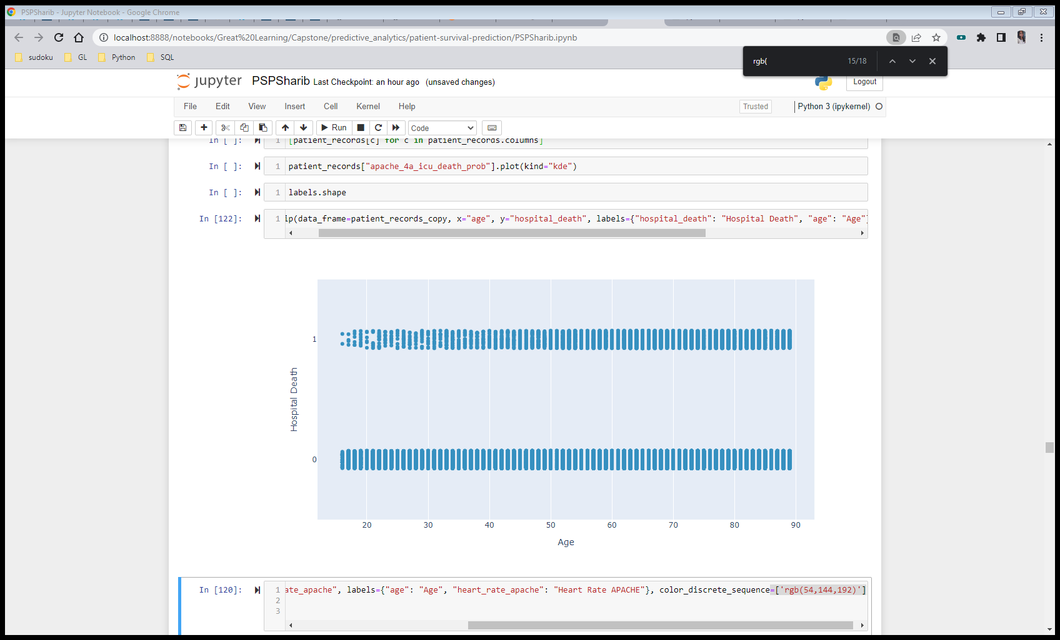
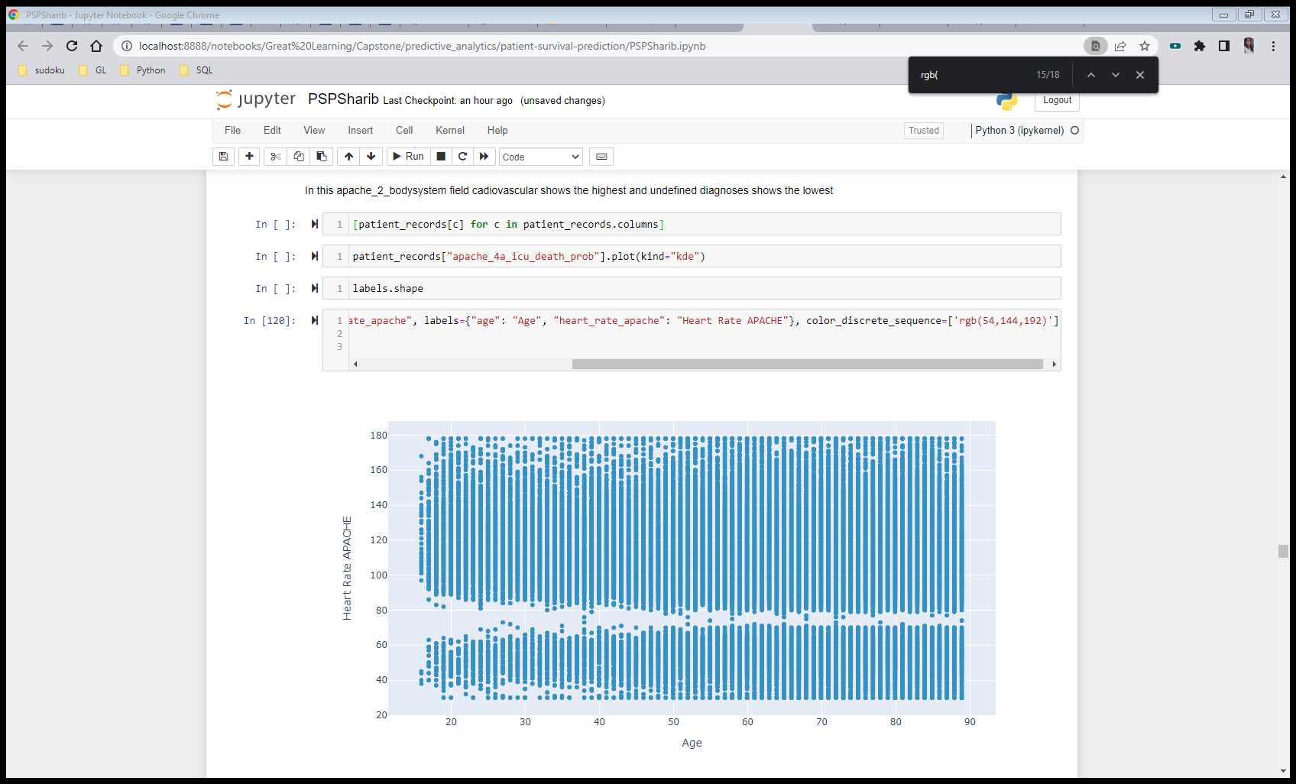
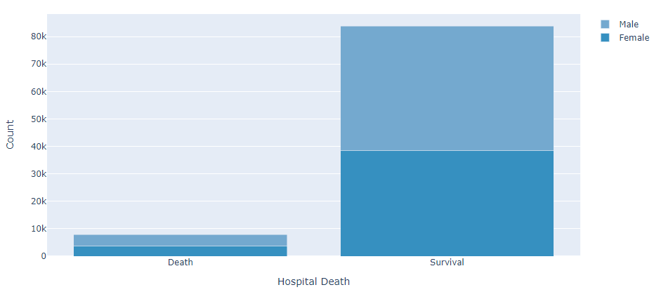
Exploratory Data Analysis Bivariate Analysis

Slide 10
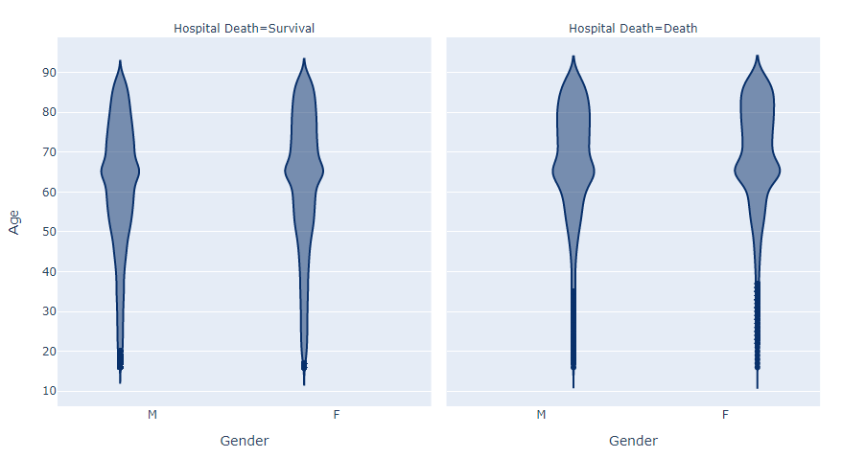
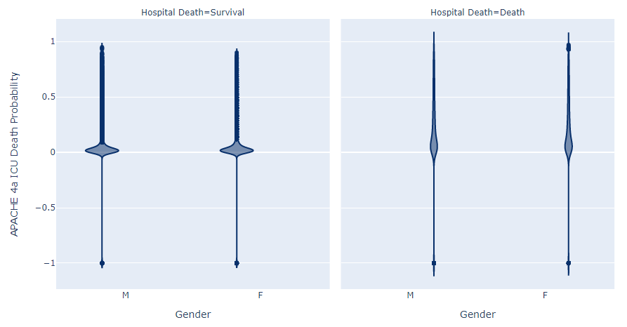
Exploratory Data Analysis Multivariate Analysis

Slide 11
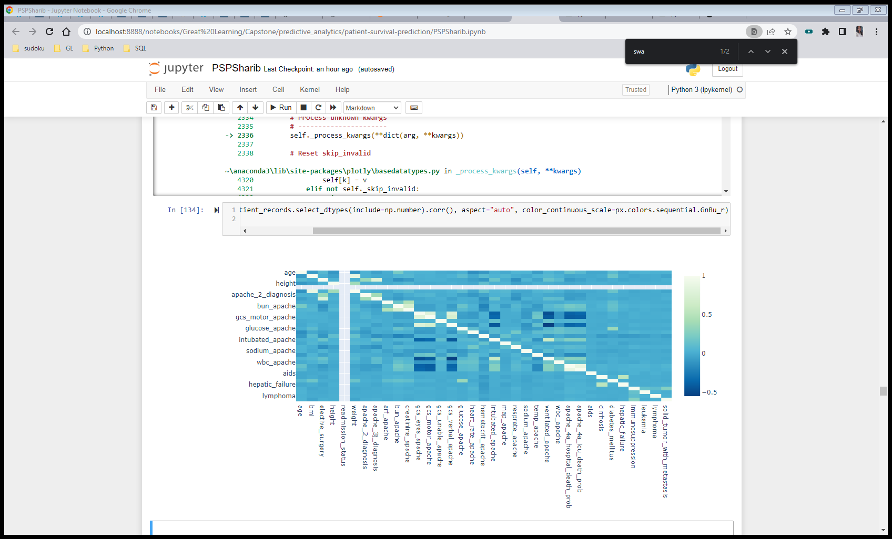
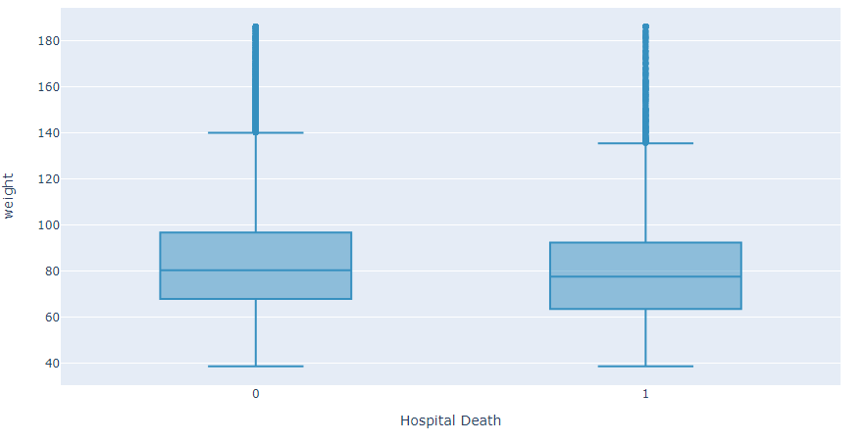
Exploratory Data Analysis
Checking for multicollinearity
The bmi, weight, bun_apache, creatinine_apache, apache_4a_hospital_death_prob, apache_4a_icu_death_prob have high correlation.
With apache_4a_icu_death_prob and apache_4a_hospital_death_prob have highest correlation of 0.879104.
Numerical-Target Analysis Outliers Yes/No
Outliers are presence in attributes like bmi, age ,weight and more.

Slide 12
Inferential Statistical Analysis: Chi-Square Test for Independence of Attributes
Sl. No | Categorical features | Target variable | Degrees of freedom | Critical Value | Test Statistic | P-value | Conclusion
1 | ethnicity | hospital_death | 5 | 11.07 | 17.59 | 0.0035 | Variable are dependent
2 | gender | hospital_death | 1 | 3.84 | 4.20 | 0.0402 | Variable are dependent
3 | hospital_admit_source | hospital_death | 14 | 23.68 | 747.06 | 0.0293 | Variable are dependent
4 | icu_admit_source | hospital_death | 4 | 9.48 | 1128.40 | 0.0528 | Variable are dependent
5 | icu_stay_type | hospital_death | 2 | 5.99 | 25.02 | 0.0368 | Variable are dependent
6 | icu_type | hospital_death | 7 | 14.06 | 246.61 | 0.0145 | Variable are dependent
7 | apache_3j_bodysystem | hospital_death | 10 | 18.30 | 1476.35 | 0.0321 | Variable are dependent
8 | apache_2_bodysystem | hospital_death | 8 | 15.50 | 1100.43 | 0.0382. | Variable are dependent

Slide 13
Non-Parametric Test – Mann Whitney U Test
Numeric Feature | Target Variable | Test Name | p-Value | Conclusion | Test Type | Test Name | p-Value | Conclusion
age | hospital_death | Shapiro-Wilks | 0 | Data is not normally distributed | Non-parametric | Mann Whitney | 0 | Difference between samples.
bmi | hospital_death | Shapiro-Wilks | 0 | Data is not normally distributed | Non-parametric | Mann Whitney | 0 | Difference between samples.
height | hospital_death | Shapiro-Wilks | 0 | Data is not normally distributed | Non-parametric | Mann Whitney | 0 | Difference between samples.
weight | hospital_death | Shapiro-Wilks | 0 | Data is not normally distributed | Non-parametric | Mann Whitney | 0 | Difference between samples.
apache_2_diagnosis | hospital_death | Shapiro-Wilks | 0 | Data is not normally distributed | Non-parametric | Mann Whitney | 0 | Difference between samples.
apache_3j_diagnosis | hospital_death | Shapiro-Wilks | 0 | Data is not normally distributed | Non-parametric | Mann Whitney | 0 | Difference between samples.
glucose_apache | hospital_death | Shapiro-Wilks | 0 | Data is not normally distributed | Non-parametric | Mann Whitney | 0 | Difference between samples.
heart_rate_apache | hospital_death | Shapiro-Wilks | 0 | Data is not normally distributed | Non-parametric | Mann Whitney | 0 | Difference between samples.
sodium_apache | hospital_death | Shapiro-Wilks | 0 | Data is not normally distributed | Non-parametric | Mann Whitney | 0.177 | Difference between samples.
temp_apache | hospital_death | Shapiro-Wilks | 0 | Data is not normally distributed | Non-parametric | Mann Whitney | 0 | Difference between samples.
ventilated_apache | hospital_death | Shapiro-Wilks | 0 | Data is not normally distributed | Non-parametric | Mann Whitney | 0 | Difference between samples.
wbc_apache | hospital_death | Shapiro-Wilks | 0 | Data is not normally distributed | Non-parametric | Mann Whitney | 0 | Difference between samples.
apache_4a_hospital_death_prob | hospital_death | Shapiro-Wilks | 0 | Data is not normally distributed | Non-parametric | Mann Whitney | 0 | Difference between samples.
apache_4a_icu_death_prob | hospital_death | Shapiro-Wilks | 0 | Data is not normally distributed | Non-parametric | Mann Whitney | 0 | Difference between samples.
aids | hospital_death | Shapiro-Wilks | 0 | Data is not normally distributed | Non-parametric | Mann Whitney | 0.187 | Difference between samples.
cirrhosis | hospital_death | Shapiro-Wilks | 0 | Data is not normally distributed | Non-parametric | Mann Whitney | 0 | Difference between samples.
diabetes_mellitus | hospital_death | Shapiro-Wilks | 0 | Data is not normally distributed | Non-parametric | Mann Whitney | 0 | Difference between samples.
immunosuppression | hospital_death | Shapiro-Wilks | 0 | Data is not normally distributed | Non-parametric | Mann Whitney | 0 | Difference between samples.
leukemia | hospital_death | Shapiro-Wilks | 0 | Data is not normally distributed | Non-parametric | Mann Whitney | 0 | Difference between samples.
lymphoma | hospital_death | Shapiro-Wilks | 0 | Data is not normally distributed | Non-parametric | Mann Whitney | 0 | Difference between samples.

Slide 14
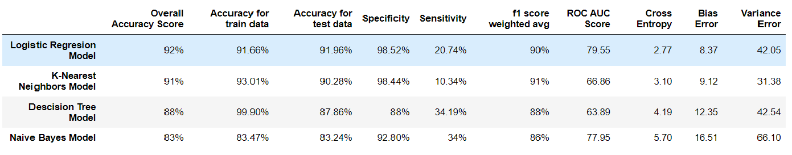
Predictive Modelling and Observations
Classification
Logistic Regression Model
K-Nearest Neighbours Classification Model
Decision Tree Classification Model
Naïve Bayes Model
We have fitted four base models for classification like Logistic Regression Model, KNN Model and a Decision Tree model and Naïve Bayes model

Slide 15
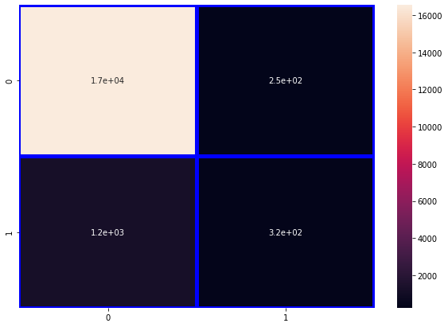

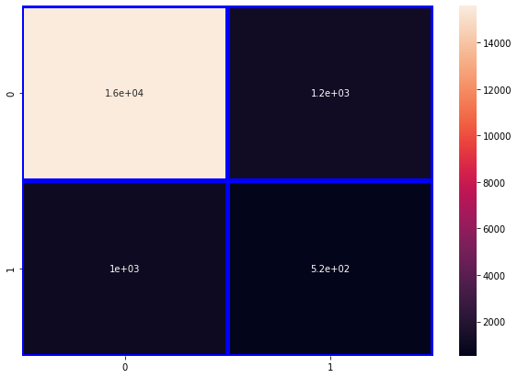
Confusion Matrix comparison
Confusion Matrix
for Logistic Regression Model :
-------------------------
[[16548 248]
[ 1226 321]]
Confusion Matrix
for K-Nearest
Neighbours’
Model :
-------------------------
[[16534 262]
[ 1387 160]]
Confusion Matrix for Decision Tree Model :
-----------------------
[[15586 1210]
[ 1022 525]]
Confusion Matrix for Naïve Bayes Model :
----------------------------
[[15586 1210]
[ 1022 525]]

Slide 16
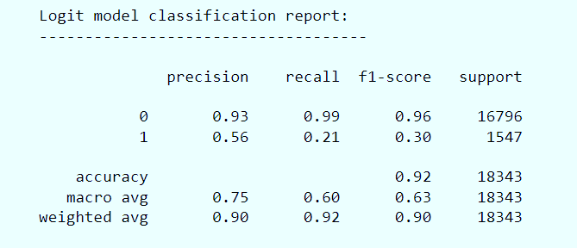
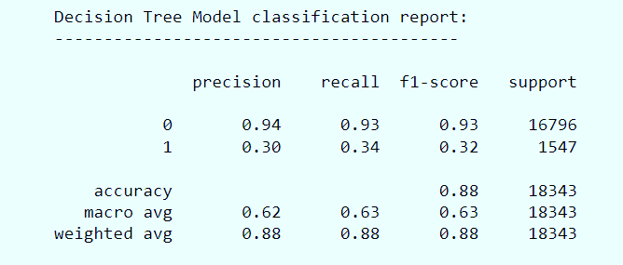
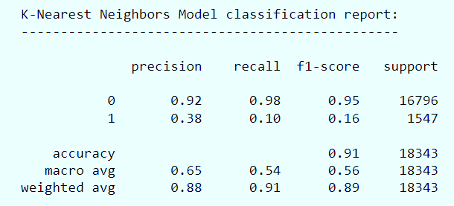
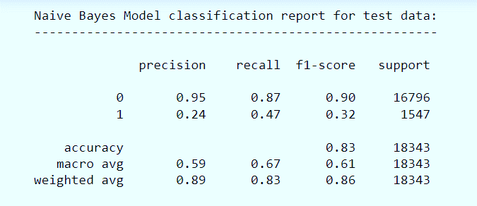
CLASSIFICATION REPORT
Specificity - 92.79%
Sensitivity - 33.93%
Specificity - 98.52%
Sensitivity - 20.74%
Specificity - 98.44%
Sensitivity – 10.34%
Specificity – 92.79%
Sensitivity – 33.93%

Slide 17
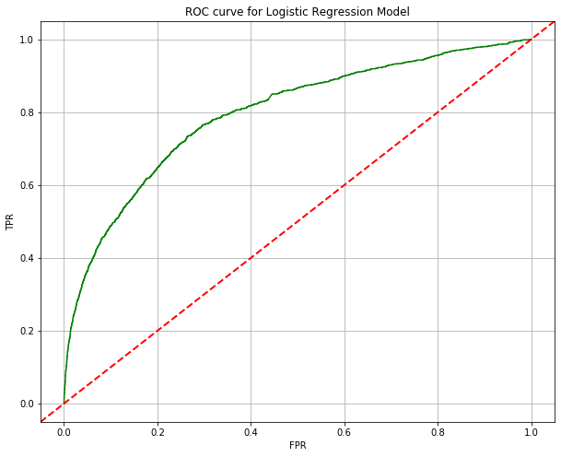
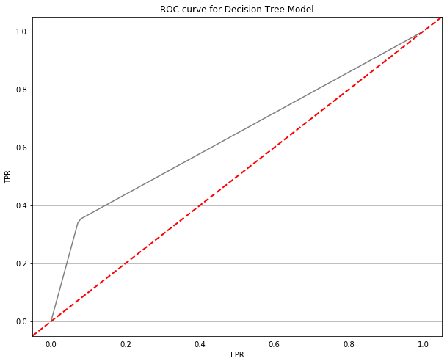


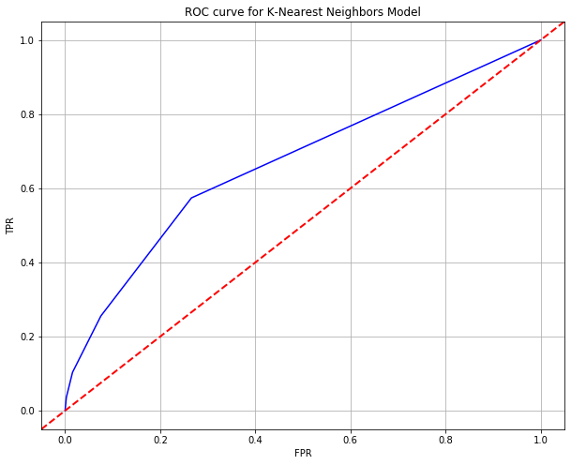
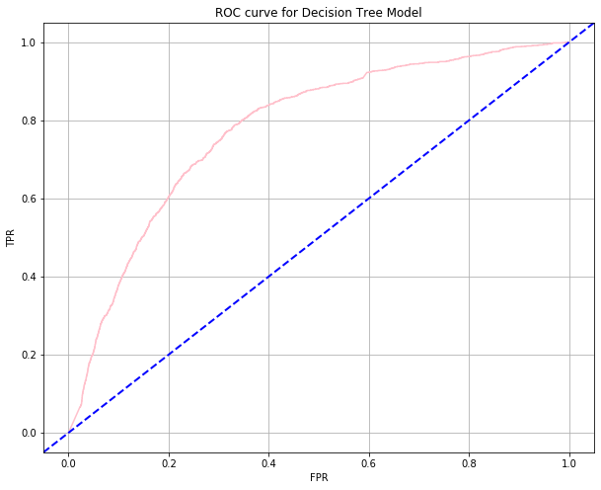


ROC Curve and ROC AUC Score
ROC AUC Score: 79.55
ROC AUC Score: 63.89
ROC AUC Score: 81.93
ROC AUC Score: 66.86
Conclusion
The Logistic Regression model has the highest AUC score.

Slide 18
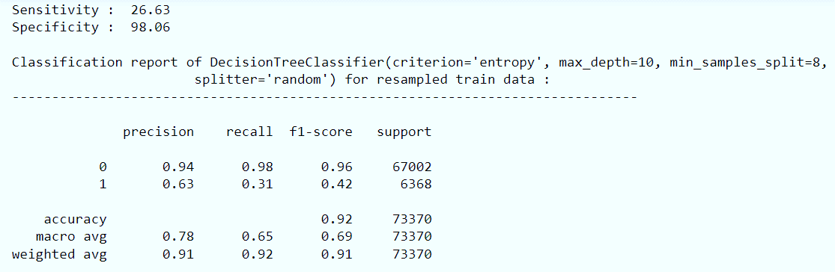
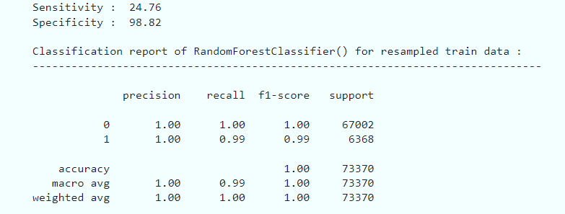
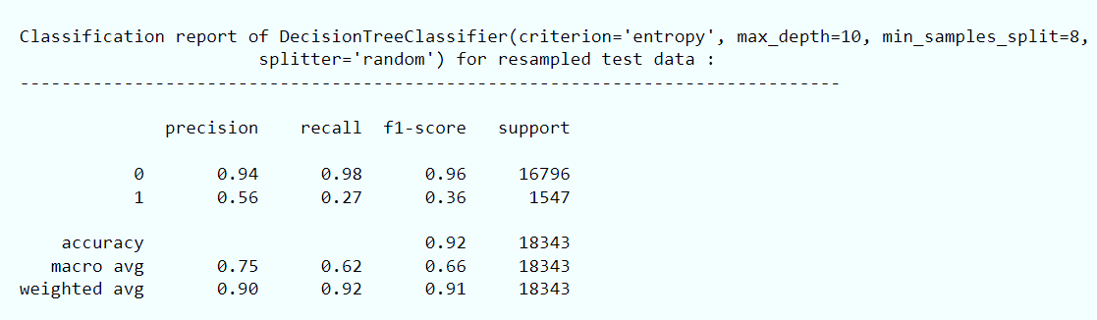
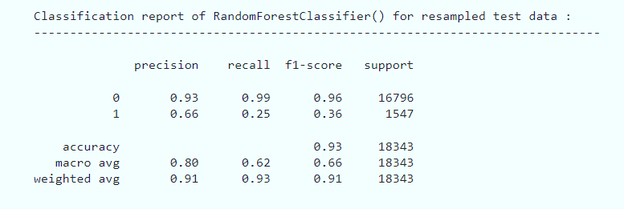
Hyperparameter tunning/Post-pruning
Each base model has been chosen and a set of parameters has been considered for fine tuning. Using these set of parameters we have used Grid Search Cross Validation technique for Hyperparameter tunning the models where the Cross Validation method considered is 10-Fold Cross Validation.

Slide 19
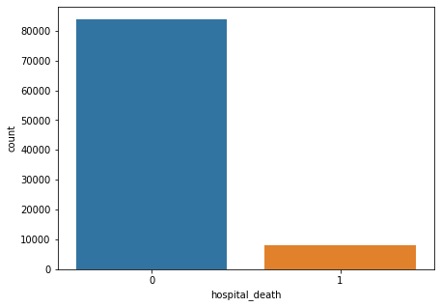
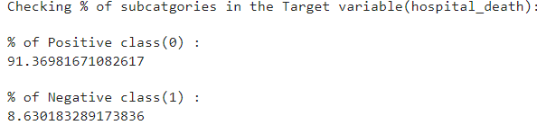
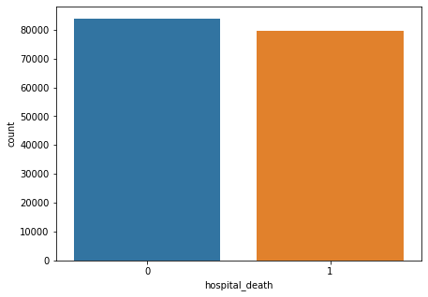
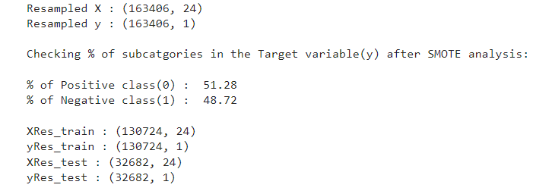
Treating Imbalanced Data
One approach to address imbalanced datasets is to oversample the minority class. The simplest approach involves duplicating examples in the minority class, although these examples don’t add any new information to the model. Instead, new examples can be synthesized from the existing examples. This is a type of data augmentation for the minority class and is referred to as the Synthetic Minority Oversampling Technique(SMOTE)
Smote Analysis

Slide 20
Feature Engineering
We have used Recursive Feature Elimination(RFE) method to obtain a subset of features which contribute significantly to the model from the overall resampled data using a base Random Forest model on the complete resampled data. The features that will be considered for further model building and optimization are :
map_apache', 'apache_4a_icu_death_prob', 'apache_2_diagnosis', 'apache_3j_diagnosis', 'apache_4a_hospital_death_prob', 'bun_apache', 'creatinine_apache', 'wbc_apache', 'gcs_verbal_apache', 'glucose_apache', 'diabetes_mellitus', 'resprate_apache'
Bagging and Boosting algorithms
Using the above features we have deployed a bagging classifier i.e. a Random Forest model with default parameters and three boosting classifiers like AdaBoost model, Gradient Boost model and XGBoost model and have done a critical analysis based on the model sensitivity and specificity,f1-weighted average and ROC AUC score to compare each model.

Slide 21
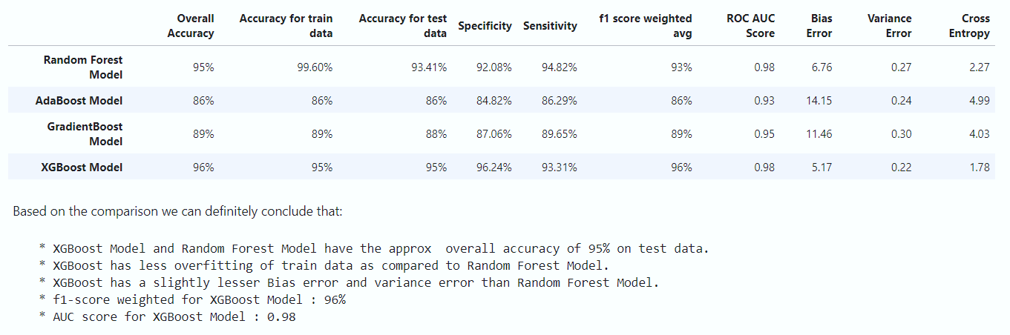
Overall Model Comparison

Slide 22
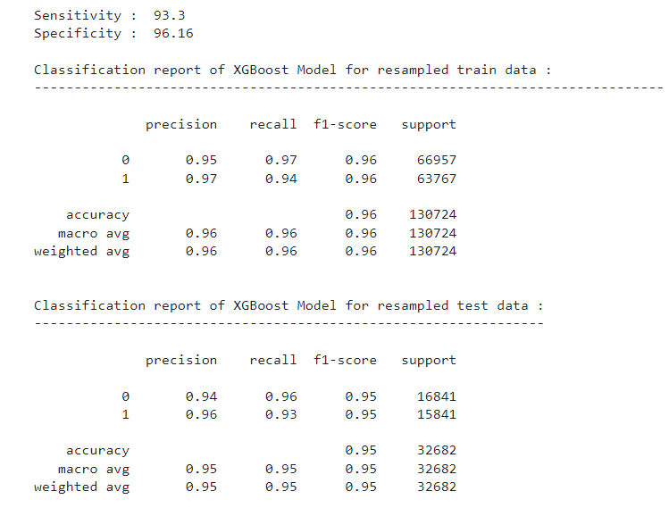
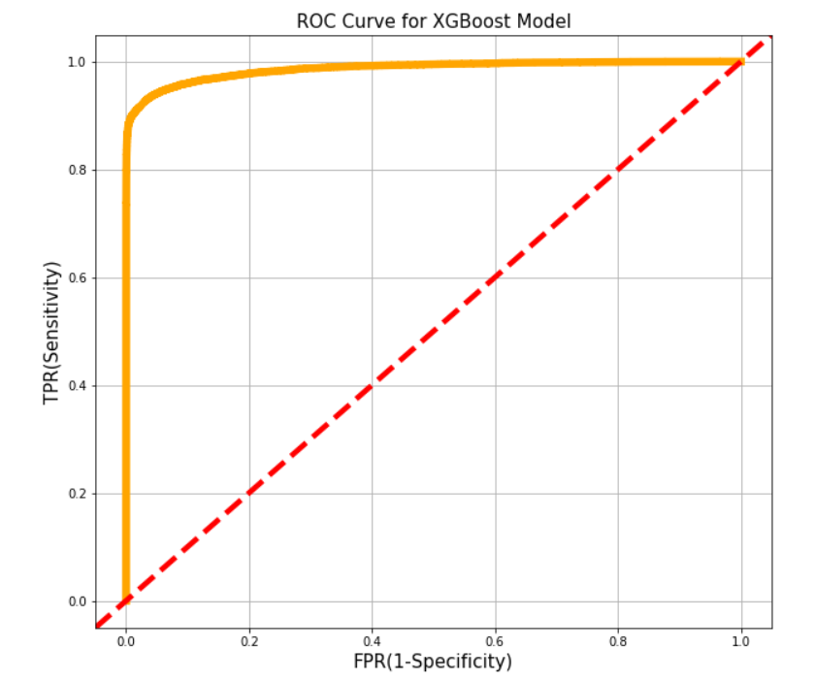
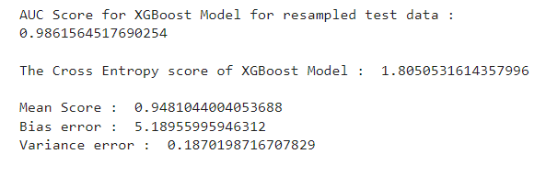

Slide 23
Thanks You!

